Slide 1
Project 67: Evaluating Identifier Quality
Mid-year Progress
Jack Chu, Jafar Maash
Coordinator: Ewan Tempero

Slide 2
Background

Slide 3
Project context
Identifiers make up over 70% of code
Having good identifiers leads to better comprehensibility + maintainability
The literature lays out a number of guidelines for identifier naming

Slide 4
Research Intent
We wish to answer the question :
“How closely do developers follow rules and guidelines when naming identifiers?”
Are there any patterns when it comes to identifier naming?

Slide 5
Plan at time of literature review
Develop code to extract identifiers from source
Javaparser
Categorise/analyse identifiers
Part of speech
Length
Casing
Compare results using different explanatory variables (pre/post introduction of IDEs, etc)
Investigate relationship between class/method names and their respective identifiers

Slide 6
Progress thus far
Develop code to extract identifiers from source
Javaparser
Categorise/analyse identifiers
Part of speech
Length
Casing
Compare results using different explanatory variables (pre/post introduction of IDEs, etc)
Investigate relationship between class/method names and their respective identifiers

Slide 7
Javaparser
A library for analysing Java code
Implemented a tool to extract all method and variable names from a project
Store in a Hashmap with their type/return type
Analyse modifiers
static, final, abstract etc.
Abide by a different set of guidelines in some cases

Slide 8
Evaluating identifiers
Currently evaluating typography of guidelines
Casing (usage of upper vs lower case)
Underscores
Length
Evaluating camelCase
Need for splitting of identifiers into their constituent words

Slide 9

CamelCase
Basic regex patterns assume an identifier is made up of >1 word
All fully lowercase identifiers counted as violations
Need a way to split identifiers to see if they contain multiple words
Will also be useful later for part of speech analysis
✅
❌

Slide 10
Identifier splitting
Two options:
Implement a greedy algorithm
Not as efficient
Find and leverage a third party library
Spiral: "SPlitters for IdentifieRs: A Library". [1]
Python Library that implements an algorithm based on the “Samurai” algorithm
Samurai best performing algorithm when compared with others [2]
Very easy to use
[1] Hucka, M. (2018). Spiral: splitters for identifiers in source code files. Journal of Open Source Software, 3(24), 653, https://doi.org/10.21105/joss.00653
[2] E. Hill, D. Binkley, D. Lawrie, L. Pollock and K. Vijay-Shanker, "An empirical study of identifier splitting techniques", Empirical Software Engineering, vol. 19, no. 6, pp. 1754-1780, 2013. Available: 10.1007/s10664-013-9261-0 [Accessed 21 July 2022].

Slide 11
Identifier splitting (cont.)
Create list of all identifiers which don’t pass basic regex camelCase check
Split them
If they split into multiple words, camelCase violation
Otherwise it should have passed initial basic regex check
E.g.

Slide 12
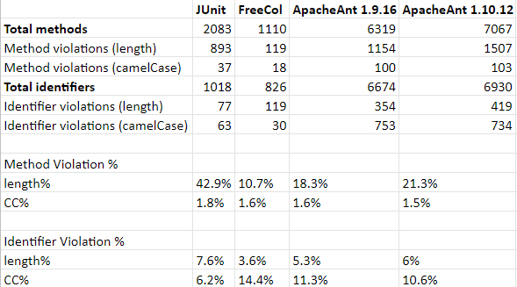
Results

Slide 13
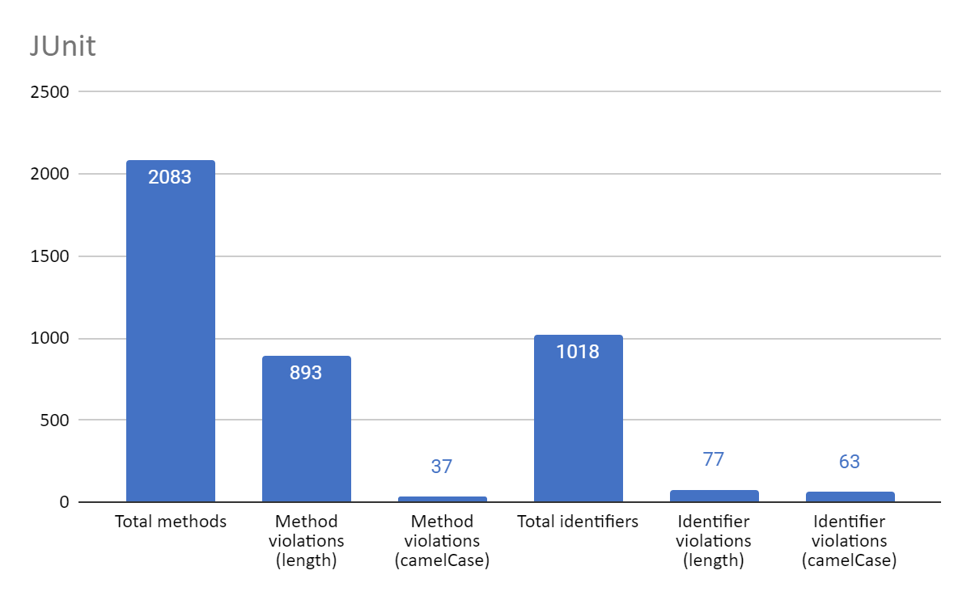
JUnit
Popular testing library
High method length violations

Slide 14
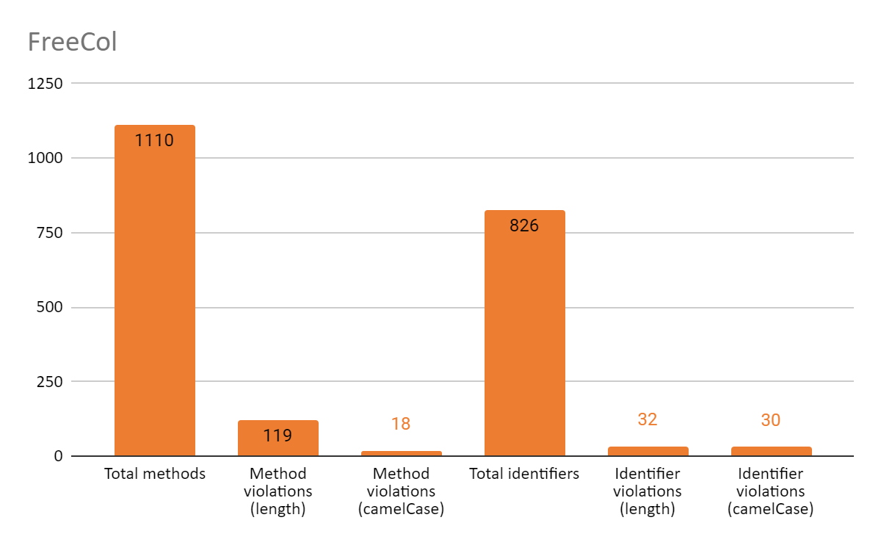
FreeCol
Open source colonisation game
Number of identifiers and methods are closer together
Once again more length violations in methods

Slide 15
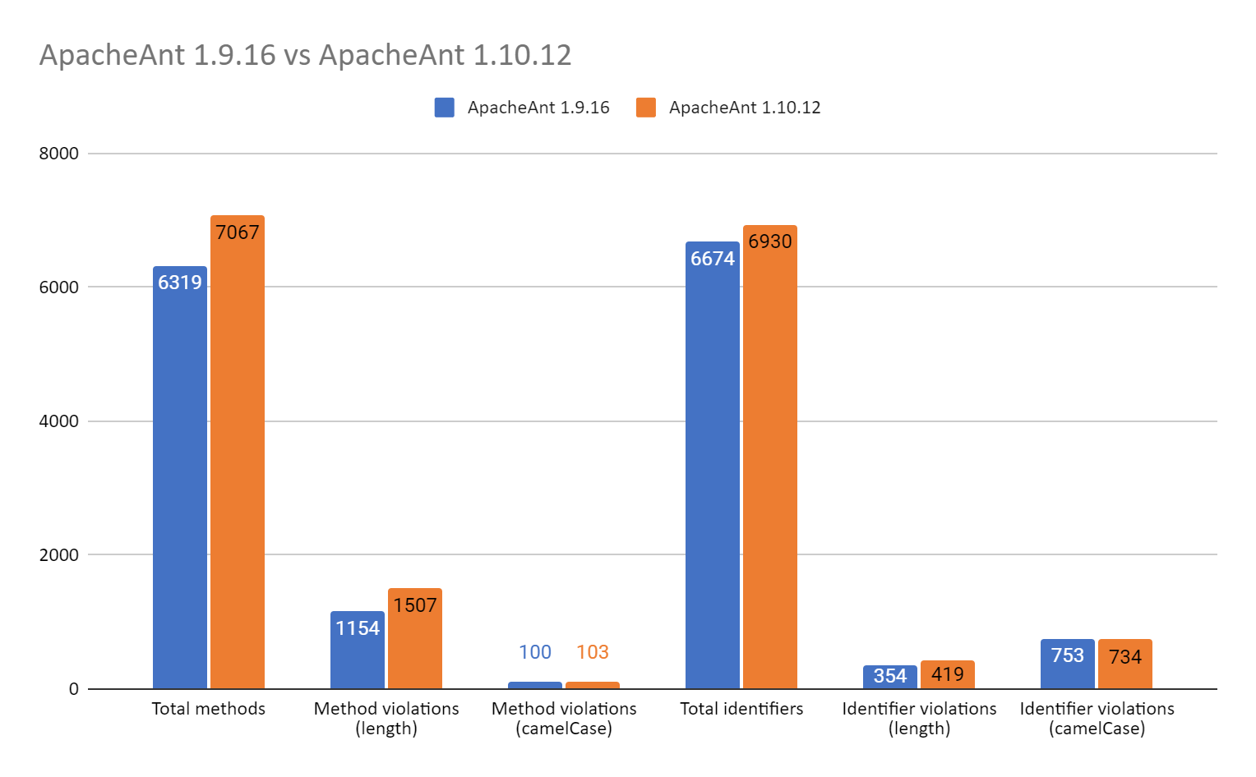
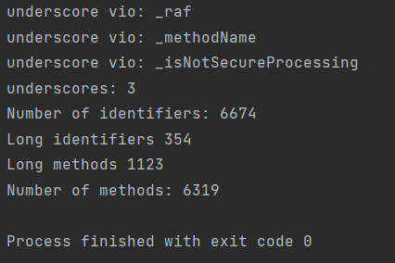
ApacheAnt
A library and command-line tool to help build software
Analysis of two different versions of ApacheAnt
Percentage remains somewhat consistent as code size increases.
Underscores removed
3 underscore violations found in ApacheAnt 1.9.16

Slide 16
Next steps
Create methods to evaluate usages of other case types, e.g. snake case, kebab case, pascal case etc.
Other guidelines, e.g. single letter abbreviations, such as “f” for File
Evaluate multiple code bases from similar categories, e.g. libraries, games, applications etc.
Compare results using different explanatory variables (pre/post introduction of IDEs, etc)
Investigate relationship between class/method names and their respective identifiers

Slide 17
Thanks For Watching

